Slide 1

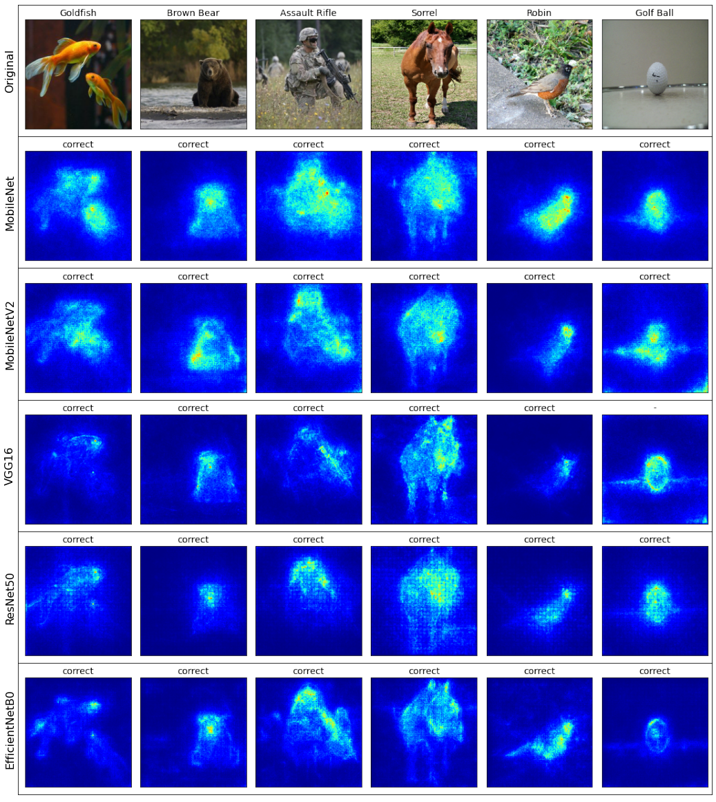
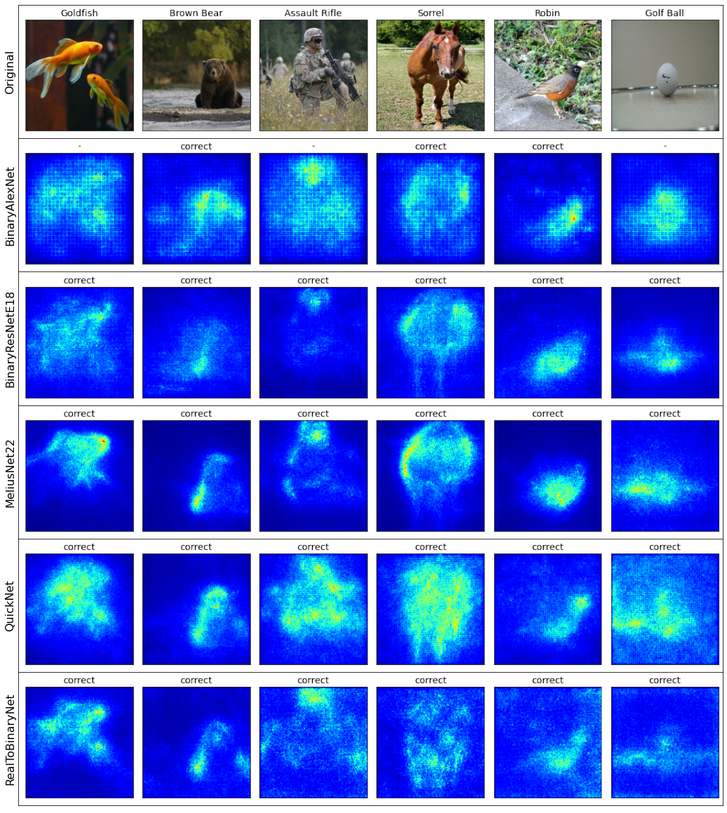
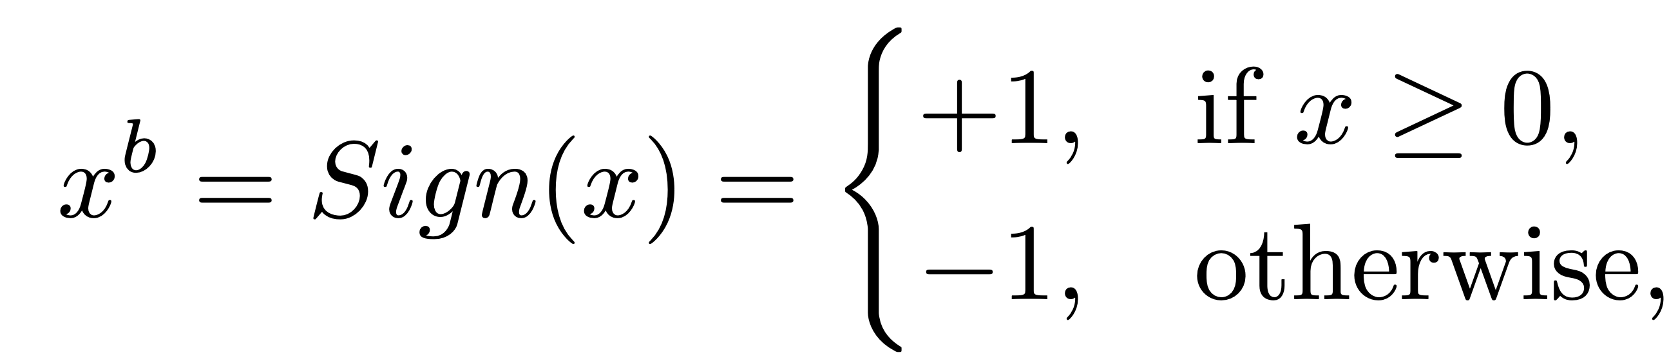
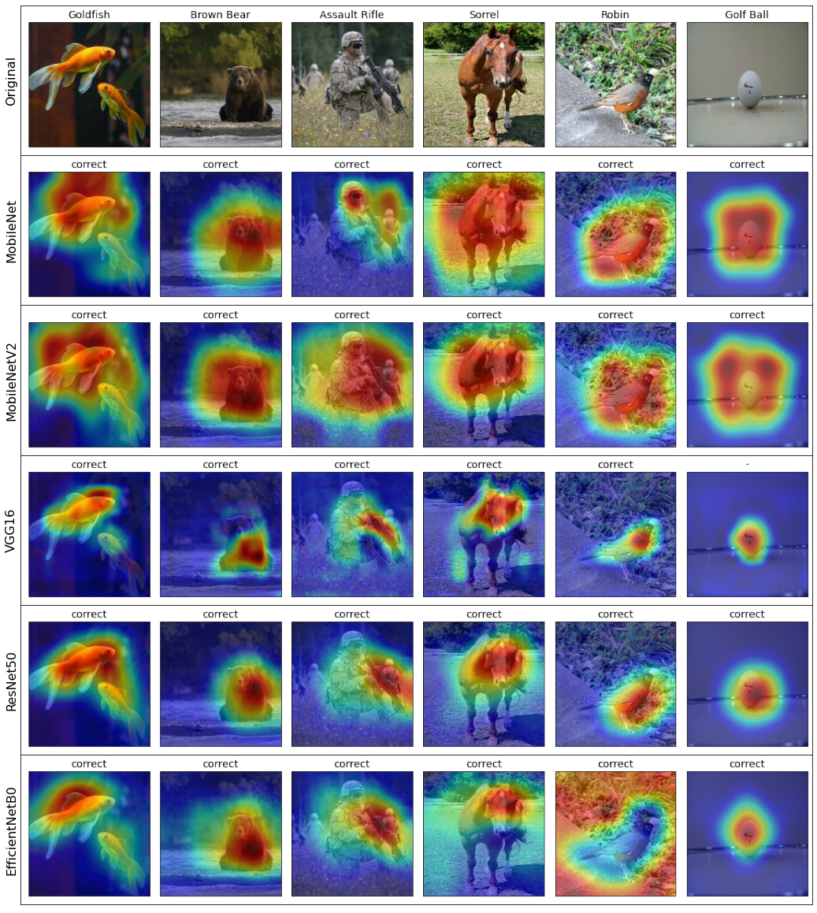
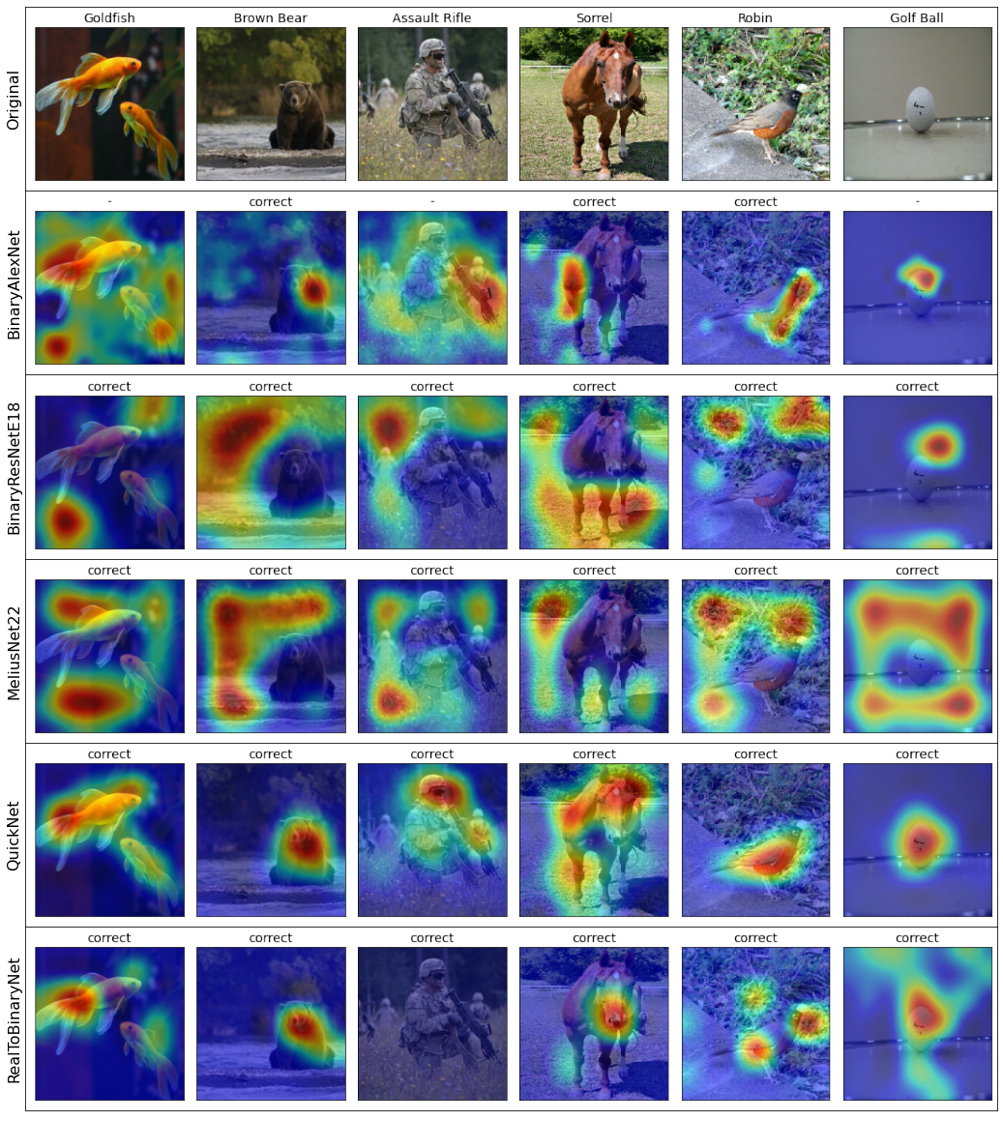
Gradient-Based Interpretability Methods and Binarized Neural Networks
FPNNs
BNNs
SmoothGrad
Amy Widdicombe, Simon J. Julier
University College London
We look at how three gradient-based saliency methods work when applied to BNNs
BNNs - Weights and activations binarized using the sign function
FPNNs
BNNs
SmoothGrad produces noisier saliency maps for BNNs and needs lower noise levels to improve maps
GradCAM produces saliency maps which can vary significantly from the FPNN equivalents
Results suggest interpretability methods should be tested on wide range of network types
GradCAM
FPNNs - Full Precision Neural Networks
BNNs - Binarized Neural Networks

